Slide 1
Replicating Process Orchestrator databases with SQL Server Replication
Cisco Platform and Services Group – CSPG
August 25th, 2016

Slide 2
Material download
https://cisco.app.box.com/files/0/f/11056240864/Cisco_Process_Orchestrator_3.3_Training_Recording_Sessions

Slide 3
Goal
Replicate OrchestratorProcess and OrchestratorReporting databases to other(s) SQL Server nodes using SQL Server Replication feature.

Slide 4
SQL Server features
SQL Server 2005
Restartable Snapshots
Oracle Publishing
Replicating all DDLs
Merge Replication allows to introduce custom business logic into the synchronization process
Merge Replication provides the ability to replicate data over HTTP with web synchronization option
Updatable Transactional Subscriptions can now handle updates to large data types at Subscribers
SQL Server 2008
Online replication (in SQL Server 2005, replication had to be stopped in order to add nodes, making schema changes, etc.)
Conflict detection capacity in peer-to-peer replication.
All types of conflicts are detected and reported through agent error log or conflicts table.
Switch partition supported
@allow_partition_switch
@replicate_partition_switch
Performance improvements, under Windows 2008
Snapshot delivery of more than 500MB/minute
Delivers 100,000 (max) records in less than 2 minutes

Slide 5
SQL Server features
SQL Server 2012
Updatable subscriptions with transactional publications are discontinued.
Four new stored procedures provide replication support for AlwaysOn.
sp_get_redirected_publisher
sp_redirect_publisher
sp_validate_replica_hosts_as_publishers
sp_validate_redirected_publisher
Replication supports the following features on Availability groups:
A publication database can be part of an availability group. The publisher instances must share a common distributor.
In an AlwaysOn Availability Group, an AlwaysOn secondary cannot be a publisher. Republishing is not supported when replication is combined with AlwaysOn.
Heterogeneous replication to non-SQL Server subscribers is deprecated
Oracle Publishing is deprecated.

Slide 6
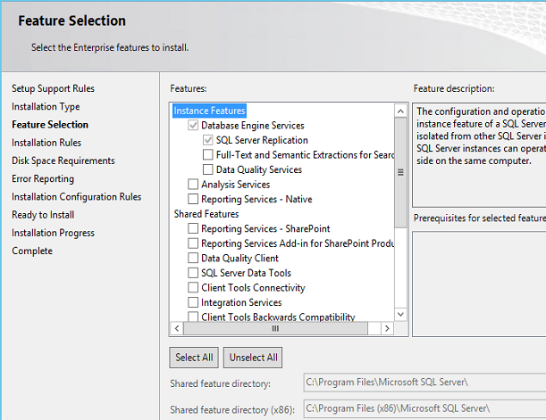
Prerequisites

Slide 7
Replication Types
Snapshot publication:
The Publisher sends a snapshot of the published data to Subscribers at scheduled intervals.
Merge publication:
The Publisher and Subscribers can update the published data independently after the Subscribers receive an initial snapshot of the published data. Changes are merged periodically. Microsoft SQL Server Compact Edition can only subscribe to merge publications.
Transactional publication:
The Publisher streams transactions to the Subscribers after they receive an initial snapshot of the published data.
Peer-to-Peer publication:
Peer-Peer publication enables multi-master replication. The publisher streams transactions to all the peers in the topology. All peer nodes can read and write changes and the changes are propagated to all the nodes in the topology.

Slide 8
Replication Entities
SQL Server replication is based on the “Publish and Subscribe” mechanism.
Publisher
It is a source database where replication starts. It makes data available for replication.
Publishers define what they publish through a publication.
Publication
Group of database objects included in replication like tables, views, indexes, etc.
Distributor
It is intermediary between publisher and subscriber.
It receives published transactions or snapshots and then stores and forwards these publications to the subscriber.

Slide 9
Replication Entities
Subscriber
It is the destination database where replication ends.
It can subscribe to multiple publications from multiple publishers.
It can send data back to publisher or publish data to other subscribers.
Subscription
It is a request by a subscriber to receive a publication.
We have two types of subscriptions - push and pull:
Push Subscriptions
With this subscription, the publisher is responsible for updating all the changes to the subscriber without the subscriber asking those changes.
Push subscriptions are created at the Publisher server
Pull Subscriptions
With this subscription the subscriber initiates the replication instead of the publisher.
The subscriptions are created at the Subscriber server.

Slide 10
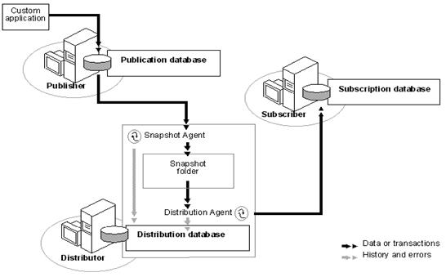
Snapshot Replication Architecture

Slide 11
Replication Agents
Snapshot Agent
Executable file that prepares snapshot files containing schema and data of published tables and db objects.
Stores the files in the snapshot folder, and records synchronization jobs in the distribution database.
Distribution Agent
Used with snapshot and transactional replication.
Applies the initial snapshot to the Subscriber and moves transactions held in the Distribution db to Subscribers.
Runs at either the Distributor for push subscriptions or at the Subscriber for pull subscriptions.
Log Reader Agent
It is used with transactional replication, which moves transactions marked for replication from the transaction log on the publisher to the distribution db.
Each DB has its own Log Reader Agent that runs on the Distributor and connects to the Publisher.

Slide 12
Replication Agents
Merge Agent
It is used with merge replication.
It applies the initial snapshot to the Subscriber and moves incremental data changes that occur.
Each merge subscription has its own Merge Agent that connects to both the Publisher and the Subscriber and updates both.
It captures changes using triggers.
Queue Reader Agent
It is used with transactional replication with the queued updating option.
It runs at the Distributor and moves changes made at the Subscriber back to the Publisher.
Unlike Distribution Agent and Merge Agent, only one instance of the Queue Reader Agent exists to serve all Publishers and publications for a given distribution db.

Slide 13
Demo

Slide 14
Demo Steps:
Configure vega-2 as Distributor;
Configure vega-1 as Publisher;
Create Publications on server-1;
Create Subscriptions on server-2;
Import Encryption Key from server-1 to server-2.
Obs: vega-1 = PO in production
vega-2 = PO contingency

